Slide 1
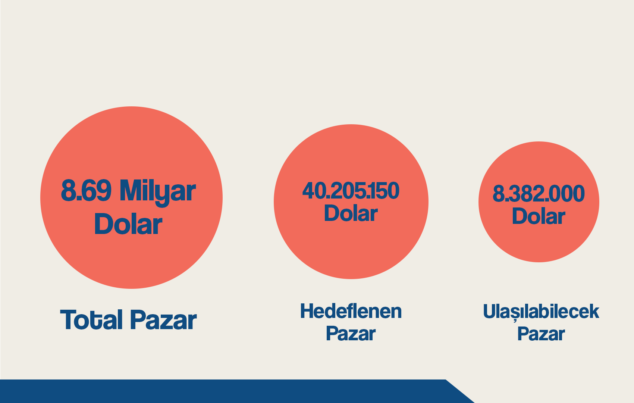
PAZAR DEĞERİ
Notes:
Global pedometre pazarı 1.9 milyar dolar:
Ref:
https://www.globenewswire.com/en/news-release/2021/01/14/2158896/28124/en/Global-2-6-Billion-Pedometers-Market-Trajectory-Analytics-to-2027-U-S-Market-is-Estimated-at-562-1-Million-While-China-is-Forecast-to-Grow-at-4-3-CAGR.html
-Global loyalty pazarı 6.79 milyar dolar:
Ref:
https://www.grandviewresearch.com/industry-analysis/loyalty-management-market-report
-Hedeflenen piyasa değeri 31.823.150,4:
Ref:
https://pitchbook.com/profiles/company/111392-74#funding
Hedeflenen piyasa değeri 8.850.000:
Ref:
https://pitchbook.com/profiles/company/43113-79#overview
1.27 (Kullanıcı başına yıllık kazanç ) * 10.000.000 (Toplam kullanıcı) %66 aktif 6.600.000
8.382.000 ulaşılabilecek Pazar
Verilerde Facebook ve Google verileri kullanılmıştır.

